Slide 1
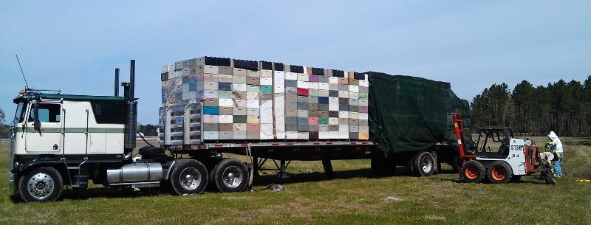
Home sick: Effects of migratory beekeeping on honey bee disease
---
P. Alexander Burnham, Samantha Alger, Leif Richardson & Zachary Lamas
keychainlogistics.com

Slide 2
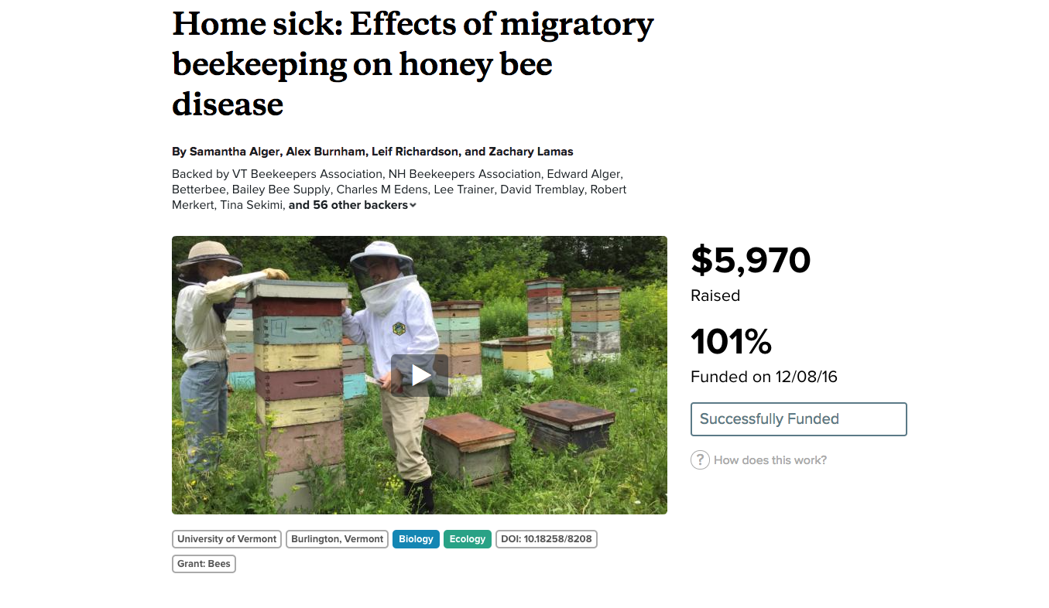
www.experiment.com/beekeeping

Slide 3





Acknowledgments
Kendall Eppley
Greer Sargeant
Nora Keathley
Gracia Archeson

Slide 4
And Most of all, our Backers…
VT Beekeepers Association, NH Beekeepers Association, Edward Alger, Betterbee, Bailey Bee Supply, Charles M Edens, Lee Trainer, David Tremblay, Robert Merkert, Tina Sekimi, Mike Kiernan, Sandra Tomlinson, Amy Handy, Joe Perry, Luke Manlove, Dan Boisvert, Jacqueline Alger, Dan O'Hanlon, Patrick Gillen, Alison K Brody,Daniel Hall Lipke, Beth Sawyer, Cathy Wilson, Allison Malloy, Richard Reid, Nicole Berthiaume, Heather Achilles, Phyllis E Burnham, Yeager Anderson, Bill Castro, Luke Tilley,Jonathan Alger, Peter Gatehouse, Amy Parachnowitsch, Trevor Brandt, Katie Iles, JESSICA PAGANO, Kate Protagonist, Andrea Stanley, Robert Zywno, Helmut Besser, Allen Turechek,Adrian Adam Zywno, Kirsten Shoshanna Traynor, Meghan O'Rourke, Jean McCartin, Ben Ritchie, Vicki Anne, Hollis Woodard, James DeRosia, The Backyard Farm, Malcolm Hobbs,Aaron Schwartz, Linda Battista, Lauren Ash, Raphaël Royauté, Kay Newhouse, Maggie Davern, Joanne Bryan, Sarah Rommelfanger, Pureum Kim, Luke McCartin, Kendall Johnson,Sara Held, Eric Damon Walters, and Bo Sprotte Kofod

Slide 5
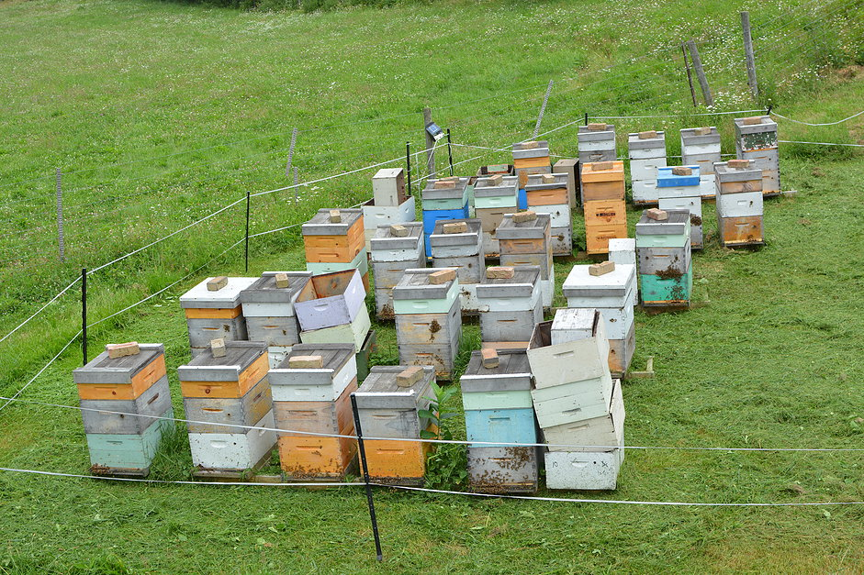
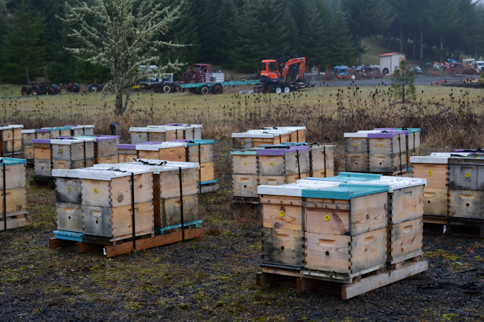
Two Main Types of Bee Operations…
Stationary Apiaries:
Migratory Apiaries:
&
bedillionhoneyfarm.com
waywardspark.com

Slide 6
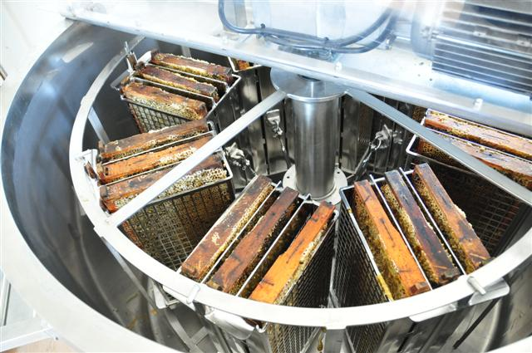
Stationary
Honey Production
Queen Breeding
Selling Nucs
Pollination
coxhoney.com

Slide 7
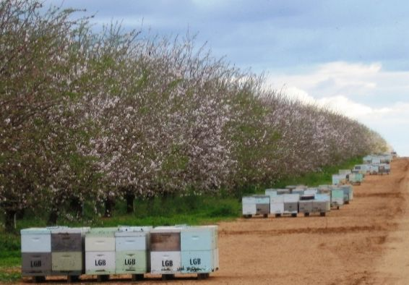
Migratory
Pollination Contracts
Almonds
Citrus
Blueberries
~60% of US colonies pollinate almonds
$14.6 Bil. industry
(Cavigli et al., 2016)
Australian Broadcasting Co.
(Morse & Calderone, 2000)

Slide 8
Anecdotally, some people believe that migratory beekeeping leads to unhealthy bees
WHY?

Slide 9


Spread of Disease
Big Cities (migratory):
-high disease transmission
Small Towns (stationary):
-low disease transmission
huffingtonpost.com

Slide 10
The big question!
“Do migratory operations contribute to the spread of honeybee disease?”

Slide 11
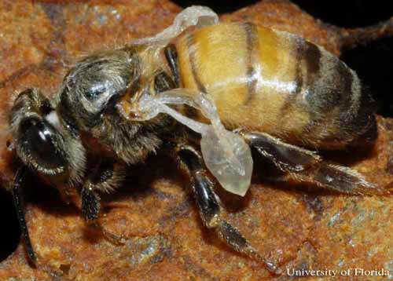
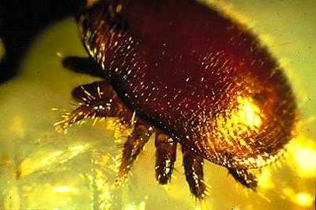
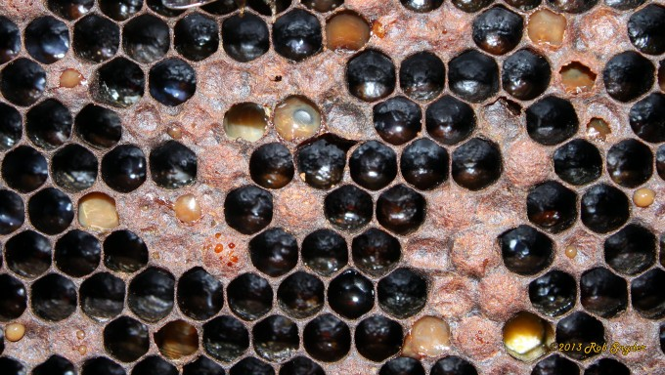
Honey Bee Pathogens:
VIRUSES:
Deformed Wing Virus (DWV)
Black Queen Cell Virus (BQCV)
Israeli Acute Paralysis Virus (IAPV)
PARASITES:
Nosema (ceranae & apis)
Varroa Mite
OTHER PATHOGENS & Pests:
American Foulbrood (AFB)
European Foulbrood (EFB)
Chalk Brood
Small Hive Beetle
Deformed wing Virus
University of Florida,
Entomology Dept.
Varroa destructor
North Carolina State University,
Cooperative Extension
American Foulbrood
Bee Informed Partnership

Slide 12
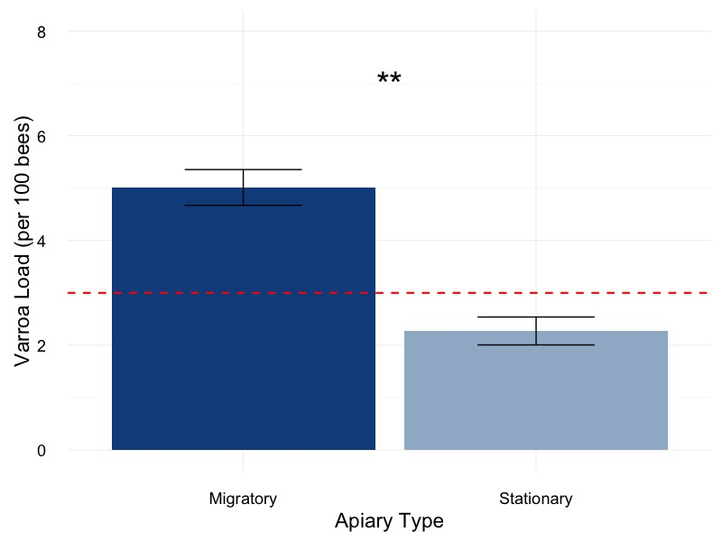
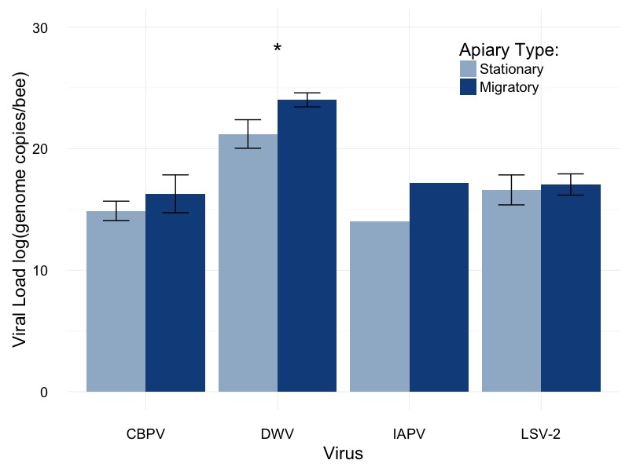
Preliminary Data from the National Honey Bee Survey in Vermont…
Varroa Mites:
RNA Viruses:

Slide 13
What other people have found:
Migratory operations can have high disease loads
Infected hives may transmit disease to other bees
Varroa loads can be lower in migratory bees
These data are correlative:
Surveys
Observational studies
(Welch et al., 2009; Cavigli et al., 2016)
(Fürst et al., 2014)
(NHBS report, 2016)

Slide 14
Our Hypotheses
Two parts to this experiment:
Part I: Do migratory colonies have higher pathogen levels than stationary colonies?
Part II: Can migratory colonies infect stationary colonies upon their return?

Slide 15
Purpose
Migratory beekeeping is very important for our agriculture and economy.
We hope to learn more about how beekeeping practices play into transmission and bee health.

Slide 16
Experimental Design
Three groups of colonies:
Migratory
Stationary (control)
Stationary (exposed)
Each group contained 16 colonies
Sampled at three different times

Slide 17

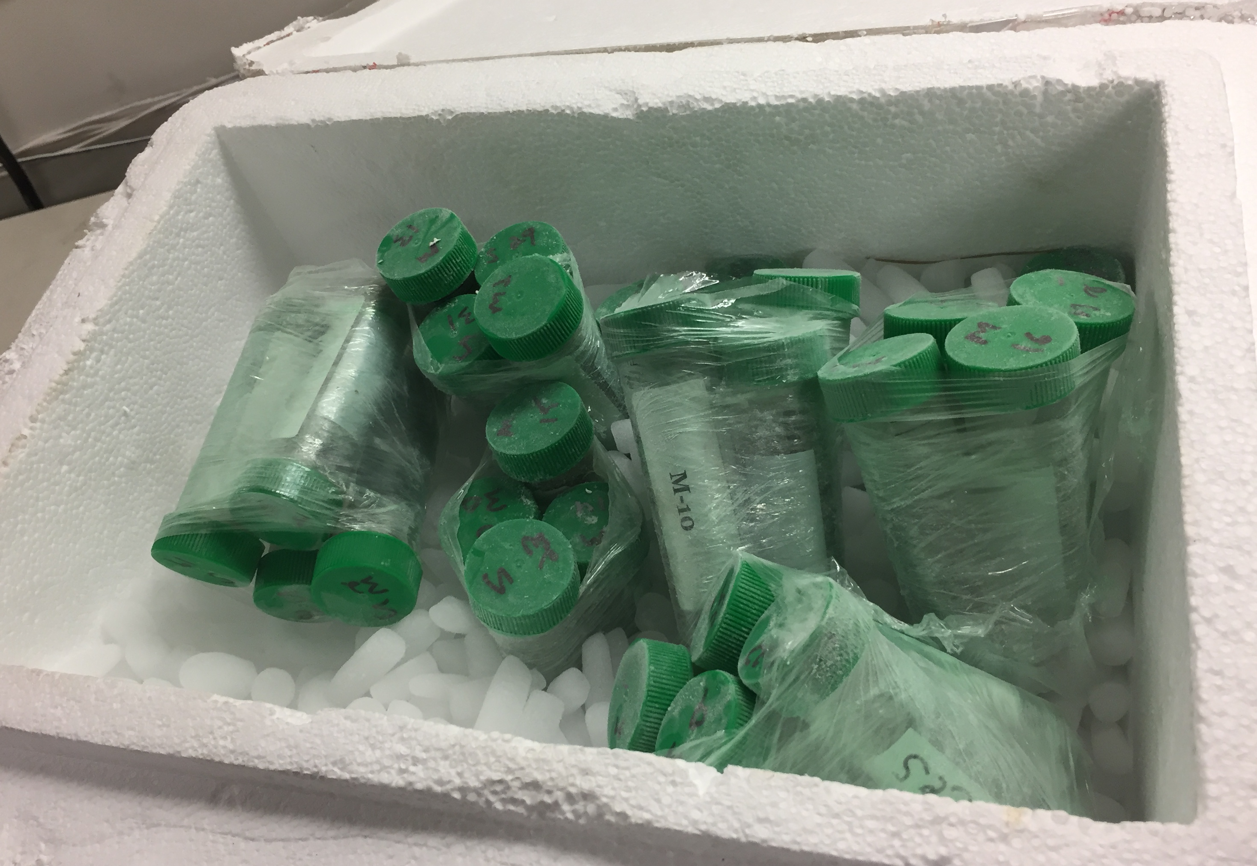
Experimental Design
Field inspection:
Common brood diseases
Frames of bees
Brood pattern
Laboratory Analysis:
Varroa load
Nosema load
Viruses: DWV, BQCV, IAPV

Slide 18



Experimental Design for Migratory/Stationary Honey Bee Experiment Part I
CA
NC
Migratory Group
Migratory Group
Stationary Group
- Do migratory colonies have higher pathogen levels than stationary colonies?

Slide 19
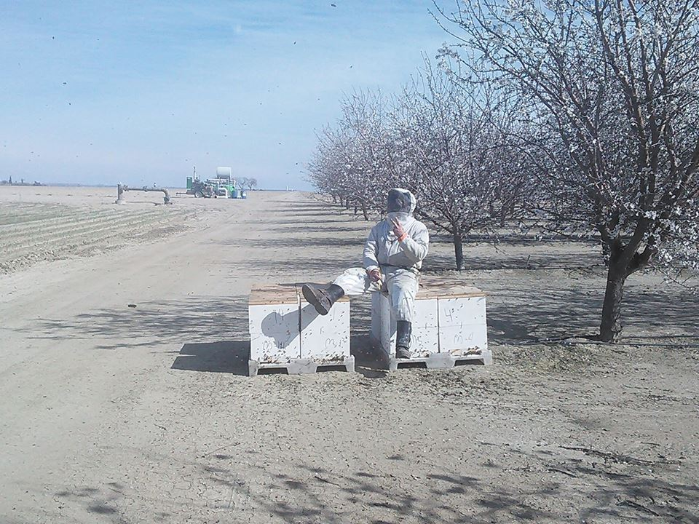

Slide 20
Do migratory colonies have higher pathogen levels than stationary colonies?
Part I: Results

Slide 21
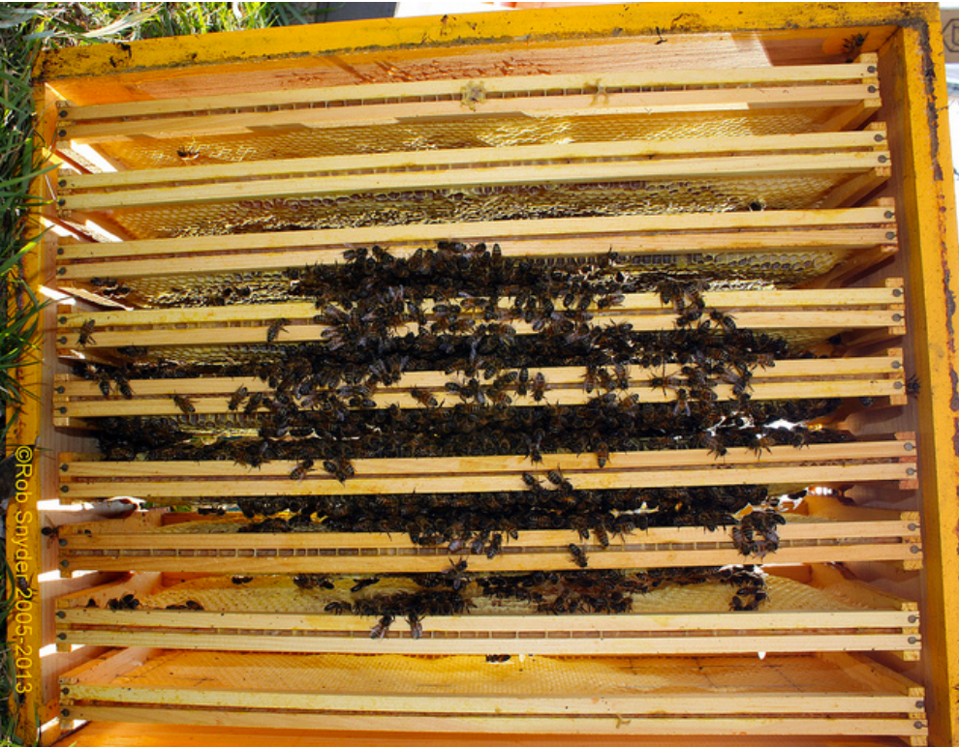
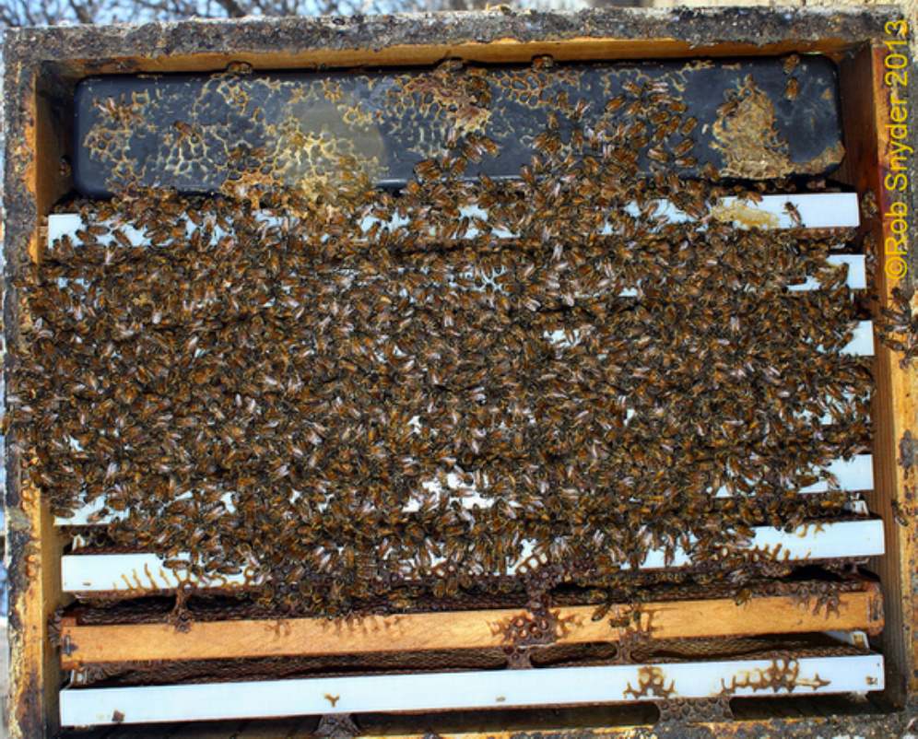
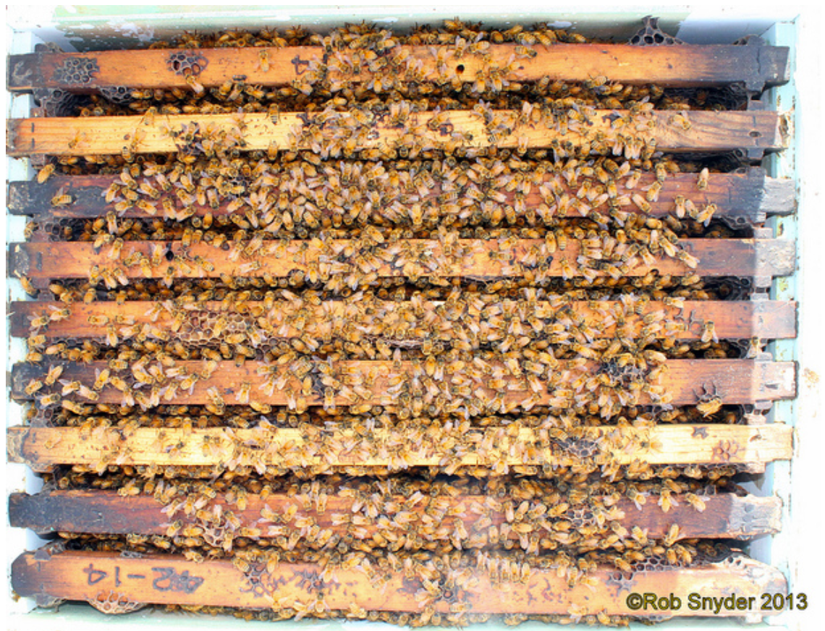
Part I: Results Frames of Bees
BIP Tech Transfer Team Protocol Manual

Slide 22
Part I: Results Frames of Bees
Notes:
Could be stress related.
We believe there was a loss of foragers during the move for the migratory hives.

Slide 23
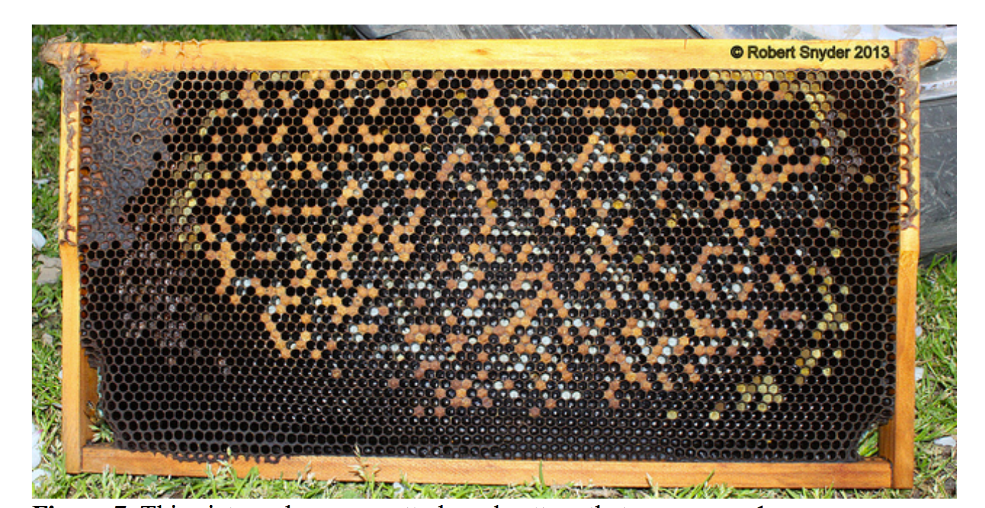
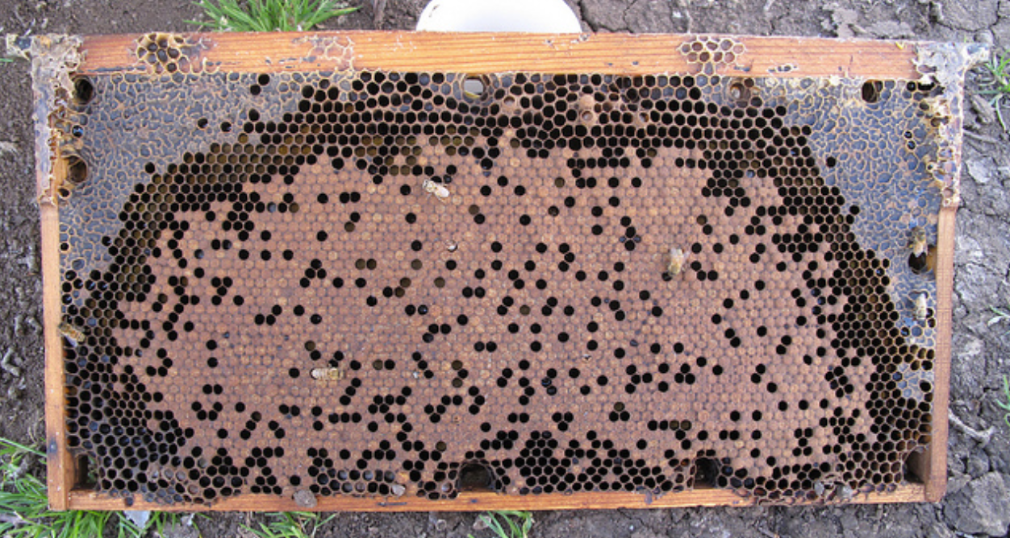
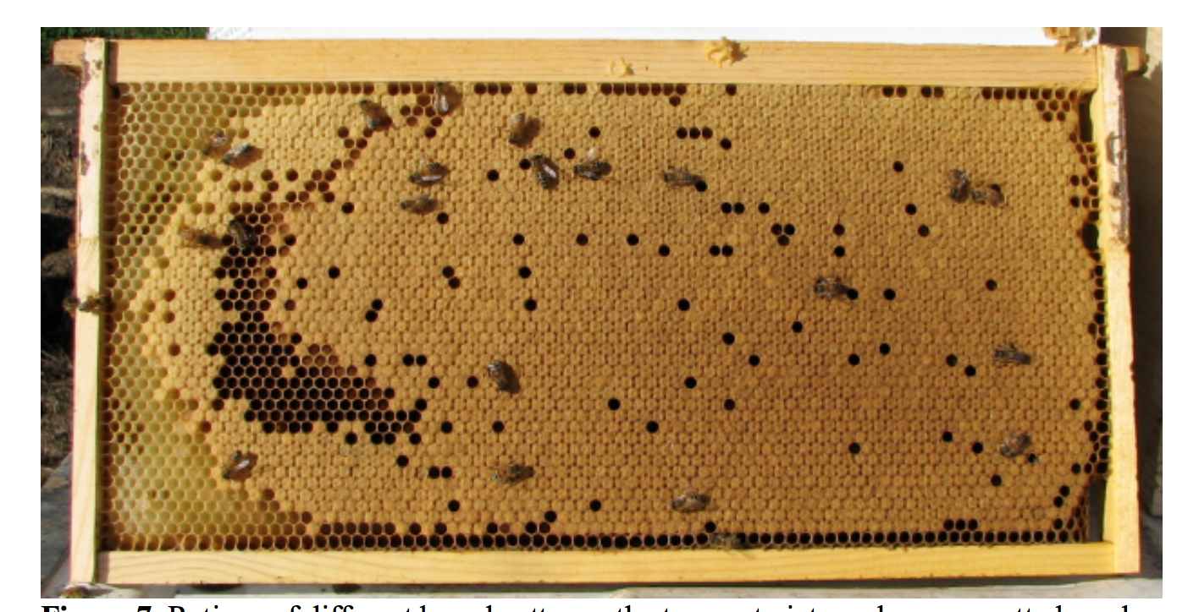
Part I: Results Brood Pattern
BIP Tech Transfer Team Protocol Manual

Slide 24
Part I: Results Brood Pattern

Slide 25
Part I: Results Varroa load
Notes:
Lower Varroa in migratory: Previous studies found lower mite loads in migratory hives and hypothesized that this was due to the bumping around while on the road in the truck. This was not the case in our study- as you see varroa loads similar right when the bees returned at time step two. However, we do see a crash in the Varroa population at time step three. We believe this could be due to the lower bee population present in the hives after the stress of the move. Since we know that Varroa populations mirror the populations of the bees in a hive.

Slide 26
Part I: Results Deformed Wing Virus Prevalence

Slide 27
Part I: Results Deformed Wing Virus Load

Slide 28
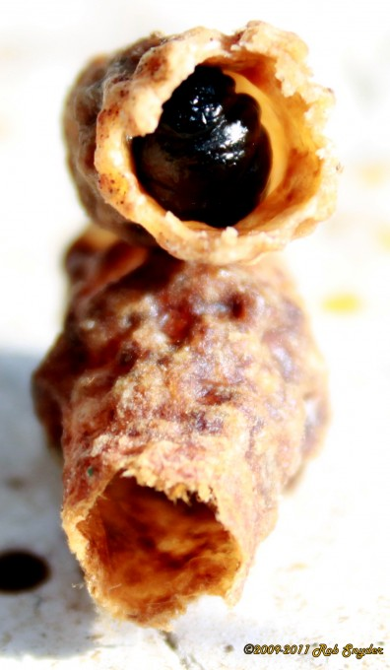
Part I: Results Black Queen Cell Virus Load
Notes:
Migratory came back with higher BQCV loads- either due to stress or exposure in the almond fields.

Slide 29
Part I: Summary
Compared to Stationary hives Migratory hives had:
Fewer frames of bees
Lower Varroa loads
Higher BQCV loads
Similar brood pattern and DWV load
No IAPV detected

Slide 30
Experimental Design for Migratory/Stationary Honey Bee Experiment Part II
CA
NC
Exposed Group
Stationary Group
(Control)
Migratory Group
- Can migratory colonies infect colonies upon their return?

Slide 31
Can migratory colonies infect stationary colonies upon their return?
Part II: Results

Slide 32
Part II: Results Frames of Bees

Slide 33
Part II: Results Brood Pattern

Slide 34
Part II: Results Varroa load

Slide 35
Part II: Results Deformed Wing Virus Prevalence
Notes:
One month after the introduction on the migratory hives, we see an increase in DWV prevalence in the exposed group.

Slide 36
Part II: Results Deformed Wing Virus Load
Notes:
We also see an increase in DWV load. Why is this? we know that varroa are vectors for DWV. And that the bee population is tightly linked to Varroa population such that as bee population increases, so does varroa and DWV load. We believe that once the migratory colonies returned, this increased the opportunity for disease transmission. Since the exposed group had a healthy bee population and increasing varroa load at the time of exposure, conditions were ripe for the transmission and replication of DWV. In addition, we do not yet know if we are looking at different strains of DWV. It is possible that the migratory colony brought back a more virulent strain that is taking advantage of the increasing mite loads and large bee population of the exposed group. Further molecular testing would help to answer this question.

Slide 37
Part II: Results Deformed Wing Virus Load
Within the colony transmission
Increases with higher bee populations and higher varroa loads (DWV vector)
Between colony transmission
Increases with higher colony density
Notes:
We also see an increase in DWV load. Why is this? we know that varroa are vectors for DWV. And that the bee population is tightly linked to Varroa population such that as bee population increases, so does varroa and DWV load. We believe that once the migratory colonies returned, this increased the opportunity for disease transmission. Since the exposed group had a healthy bee population and increasing varroa load at the time of exposure, conditions were ripe for the transmission and replication of DWV. In addition, we do not yet know if we are looking at different strains of DWV. It is possible that the migratory colony brought back a more virulent strain that is taking advantage of the increasing mite loads and large bee population of the exposed group. Further molecular testing would help to answer this question.

Slide 38
Part II: Results Black Queen Cell Virus Load
Notes:
We see a converging of the BQCV loads, where the migratory hives are converging to the levels of the other two groups. It appears that migratory conditions increased the viral loads, but did not appear to affect the exposed group.

Slide 39
Part 2: Summary
Compared to the Stationary (Control) hives, Exposed hives had:
Higher DWV load and prevalence
More frames of bees
Similar BQCV loads, Varroa loads, Brood pattern
No IAPV detected

Slide 40
Overall Summary
Negative effects of migratory conditions: Reduced bee population
Increased BQCV load
Positive effects of migratory conditions:
Reduced varroa load
The DWV load increased in the exposed group after one month of exposure to the migratory group. Is this simply due to higher colony density?

Slide 41
Future Work
Test samples for other viruses.
Sequence viruses to see if strains are different between migratory and stationary hives.

Slide 42
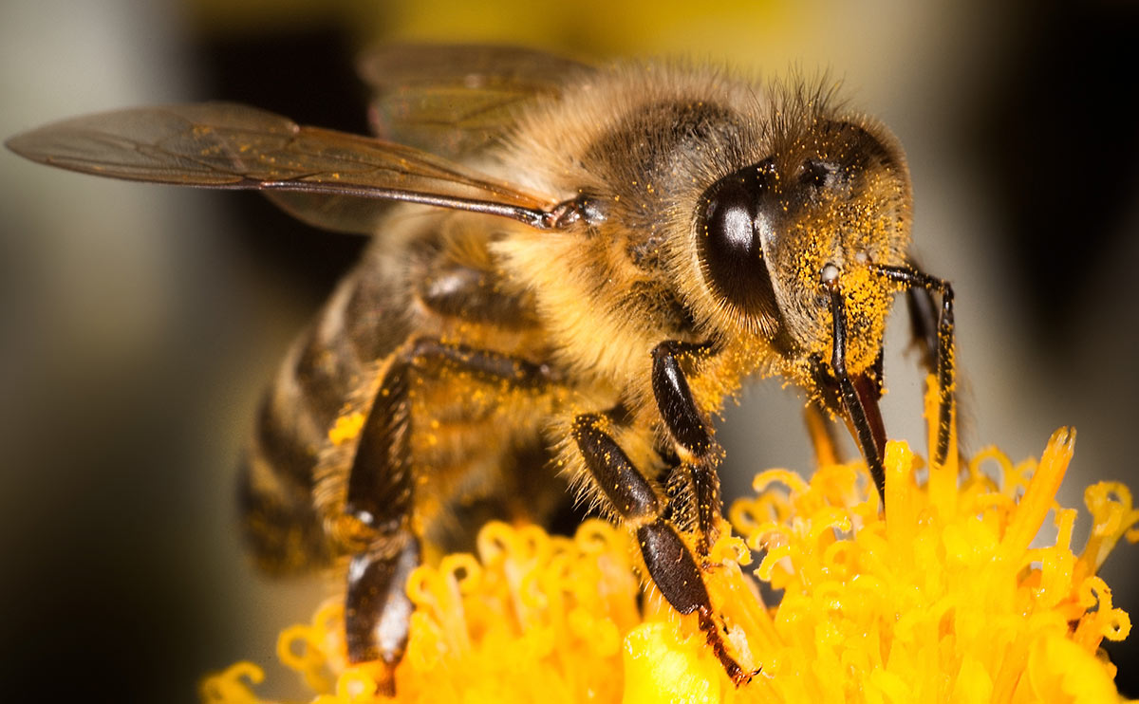
Thank You!

Slide 43
Questions?

Slide 44
